Slide 1
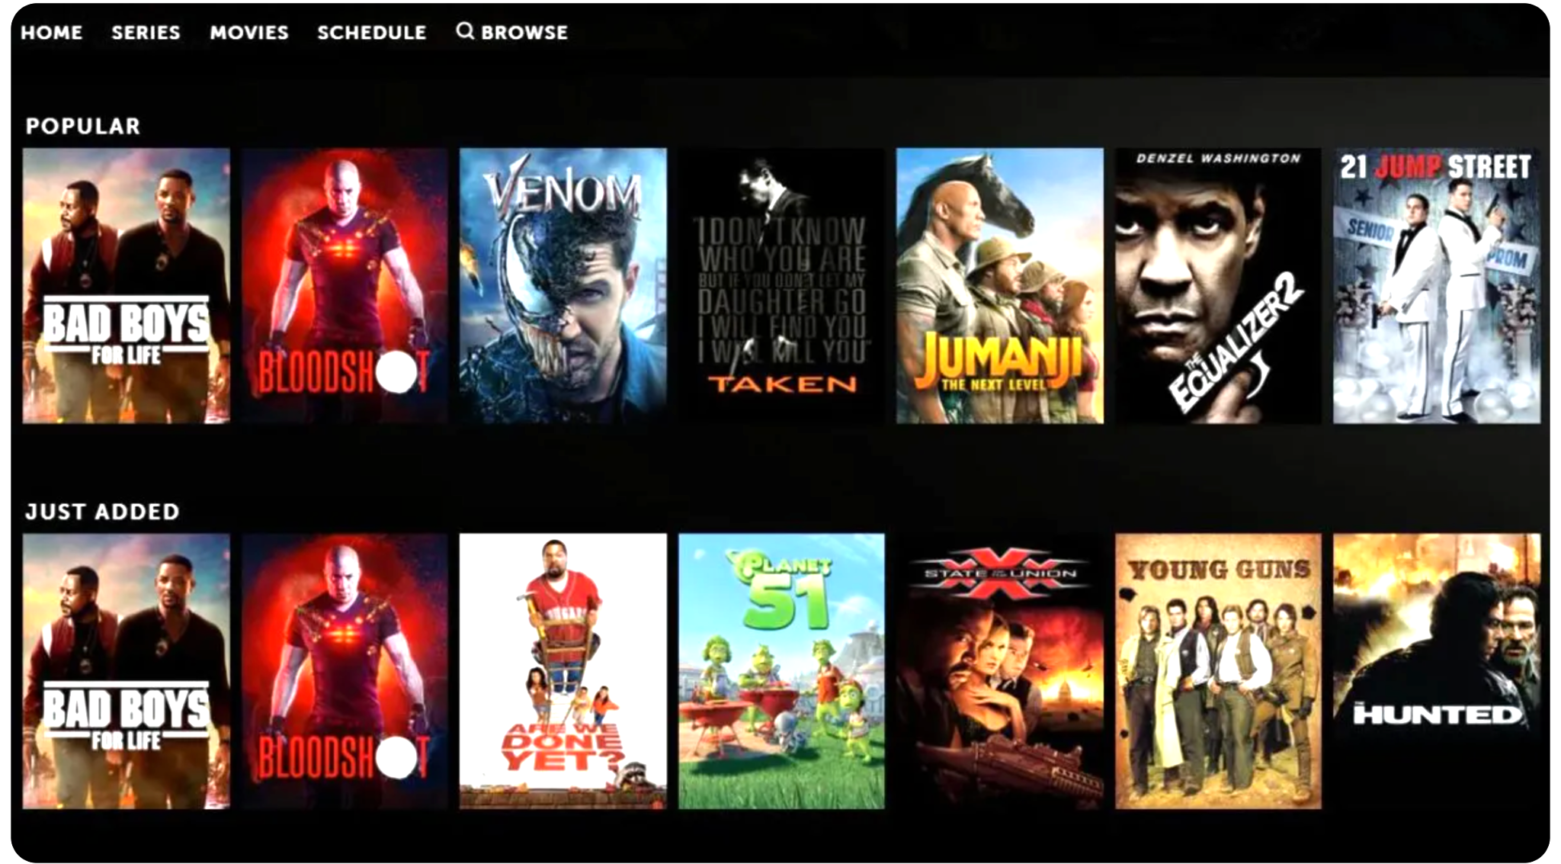
Movie Analysis: Predictions and Recommendations
Group 18:
Dharini Baskaran
Vignesh Kumar Karthikeyan
Sabina Adhikari

Slide 2
MOTIVATION:
Interest in movies.
Movie industry has great impact on global economy.
Understand the algorithms used by digital platforms to make recommendations.
Understand the factors that affect the revenue of movies.

Slide 3
DATASETS:
https://www.kaggle.com/datasets/shubhammehta21/movie-lens-small-latest-dataset
Files:
movies.csv - movieId, title, genre
ratings.csv - userId, movieId, rating, timestamp
https://www.kaggle.com/datasets/rounakbanik/the-movies-dataset
Files:
movie_metadata.csv - 23 attributes on revenue, vote, language, poster and more.

Slide 4
DATA PREPROCESSING:
Missing value imputation
Outlier detection
Correlation Matrix Analysis
Temporal Analysis of Genre Popularity
Highest-Rated Genre by Year
Distribution of user Ratings
Frequently used Terms in Blockbuster Films

Slide 5
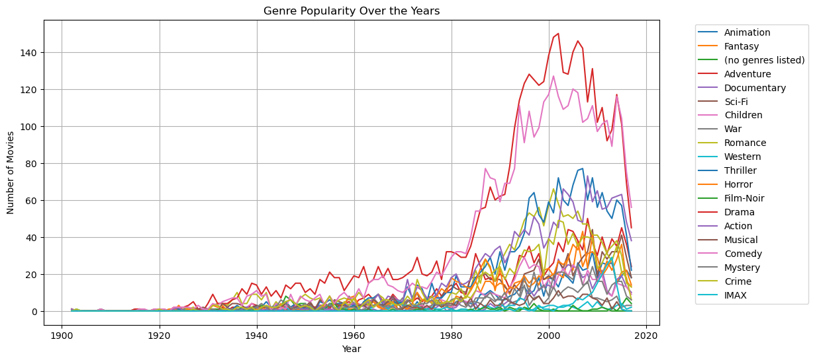
DATA VISUALISATION:
Temporal Analysis of Genre Popularity

Slide 6
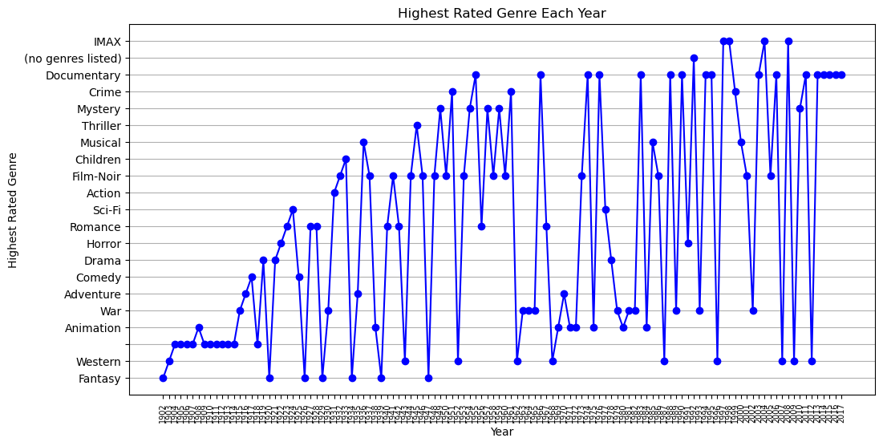
DATA VISUALISATION:
Highest-Rated Genre by Year

Slide 7
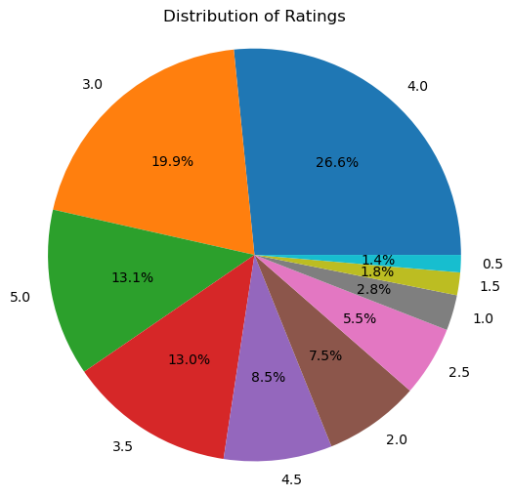
DATA VISUALISATION:
Distribution of User Ratings

Slide 8
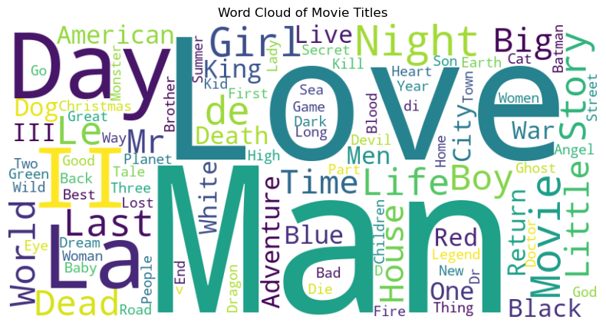
DATA VISUALISATION:
Frequently used Terms in Blockbuster Films

Slide 9
RECOMMENDATION MODEL:
Collaborative Filtering:
Importing Data
Data Preprocessing
Removing Noise from Data
Removing Sparsity
Designing Movie Recommendation System Model
Recommend Similar Movies

Slide 10
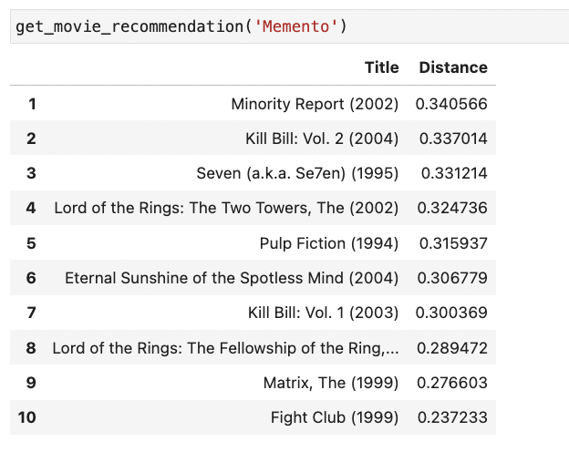
RECOMMENDATION MODEL:
Collaborative Filtering:

Slide 11
RECOMMENDATION MODEL:
Hybrid model:
Importing Data
Include Genre Information
Movie Data TF-IDF Weighting
Include Rating Information
Designing Movie Recommendation System Model
Recommend Similar Movies

Slide 12
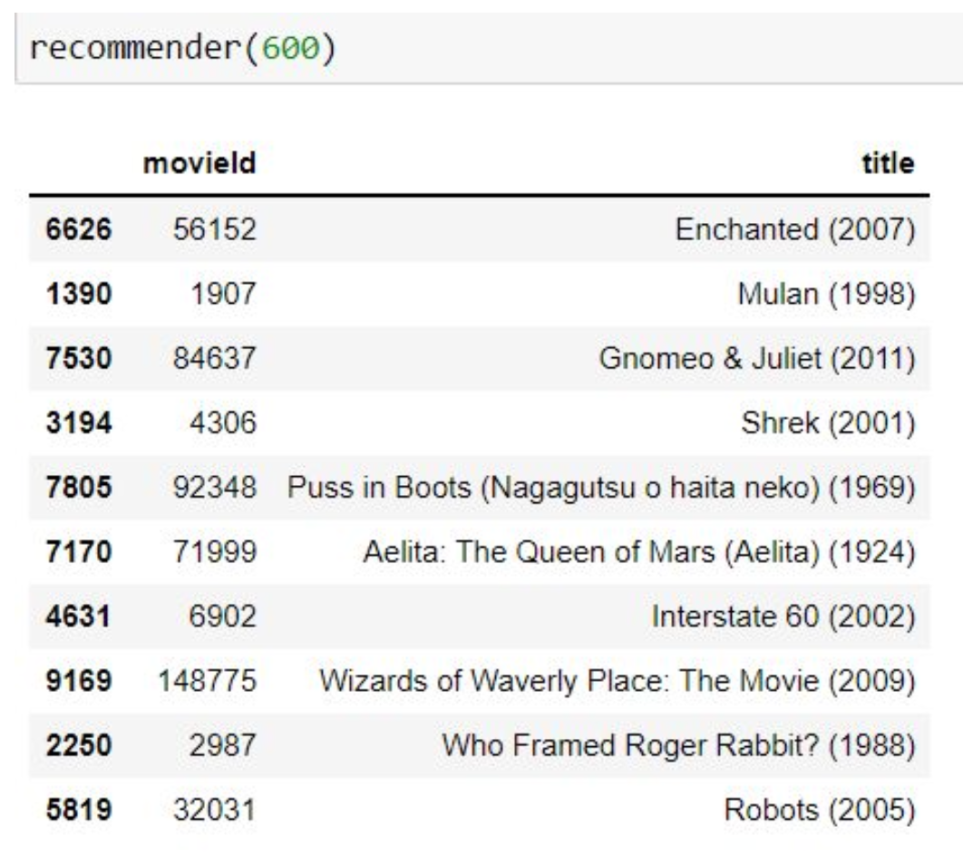
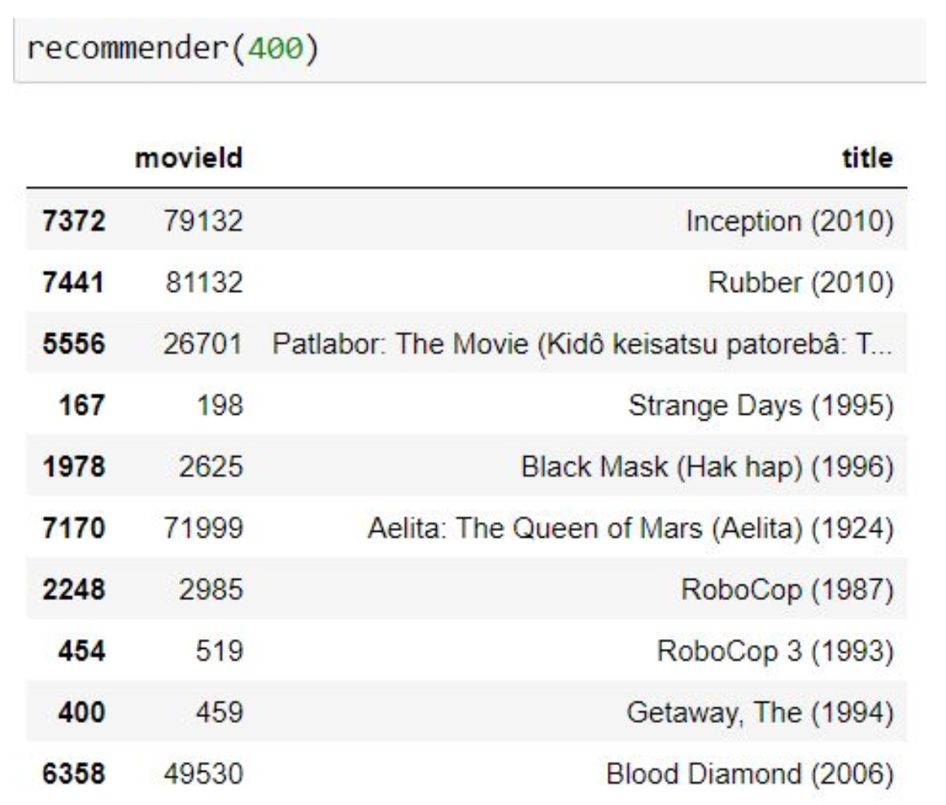
RECOMMENDATION MODEL:
Hybrid model:

Slide 13
RECOMMENDATION MODEL:
When you are using collaborative filtering, the model will recommend movies, which other users have rated or watched similarly. Thus it will recommend without considering the user’s watch list.
This limitation is overcome in the hybrid model by using content-filtering method so that even the user’s interests are acknowledges leading to better results.
The TF-IDF technique is used to find similar movies by measuring the importance of each genre in a particular movie.

Slide 14
PREDICTION MODEL:
Prediction model based on linear regression model
y = ax + b
Dependent variable: Revenue
Independent variables: Budget, Popularity, Vote Counts, Vote Average, Runtime
Processed Data splitted into training and testing set
Fit linear regression model into training set
Fitted regression model used for prediction

Slide 15
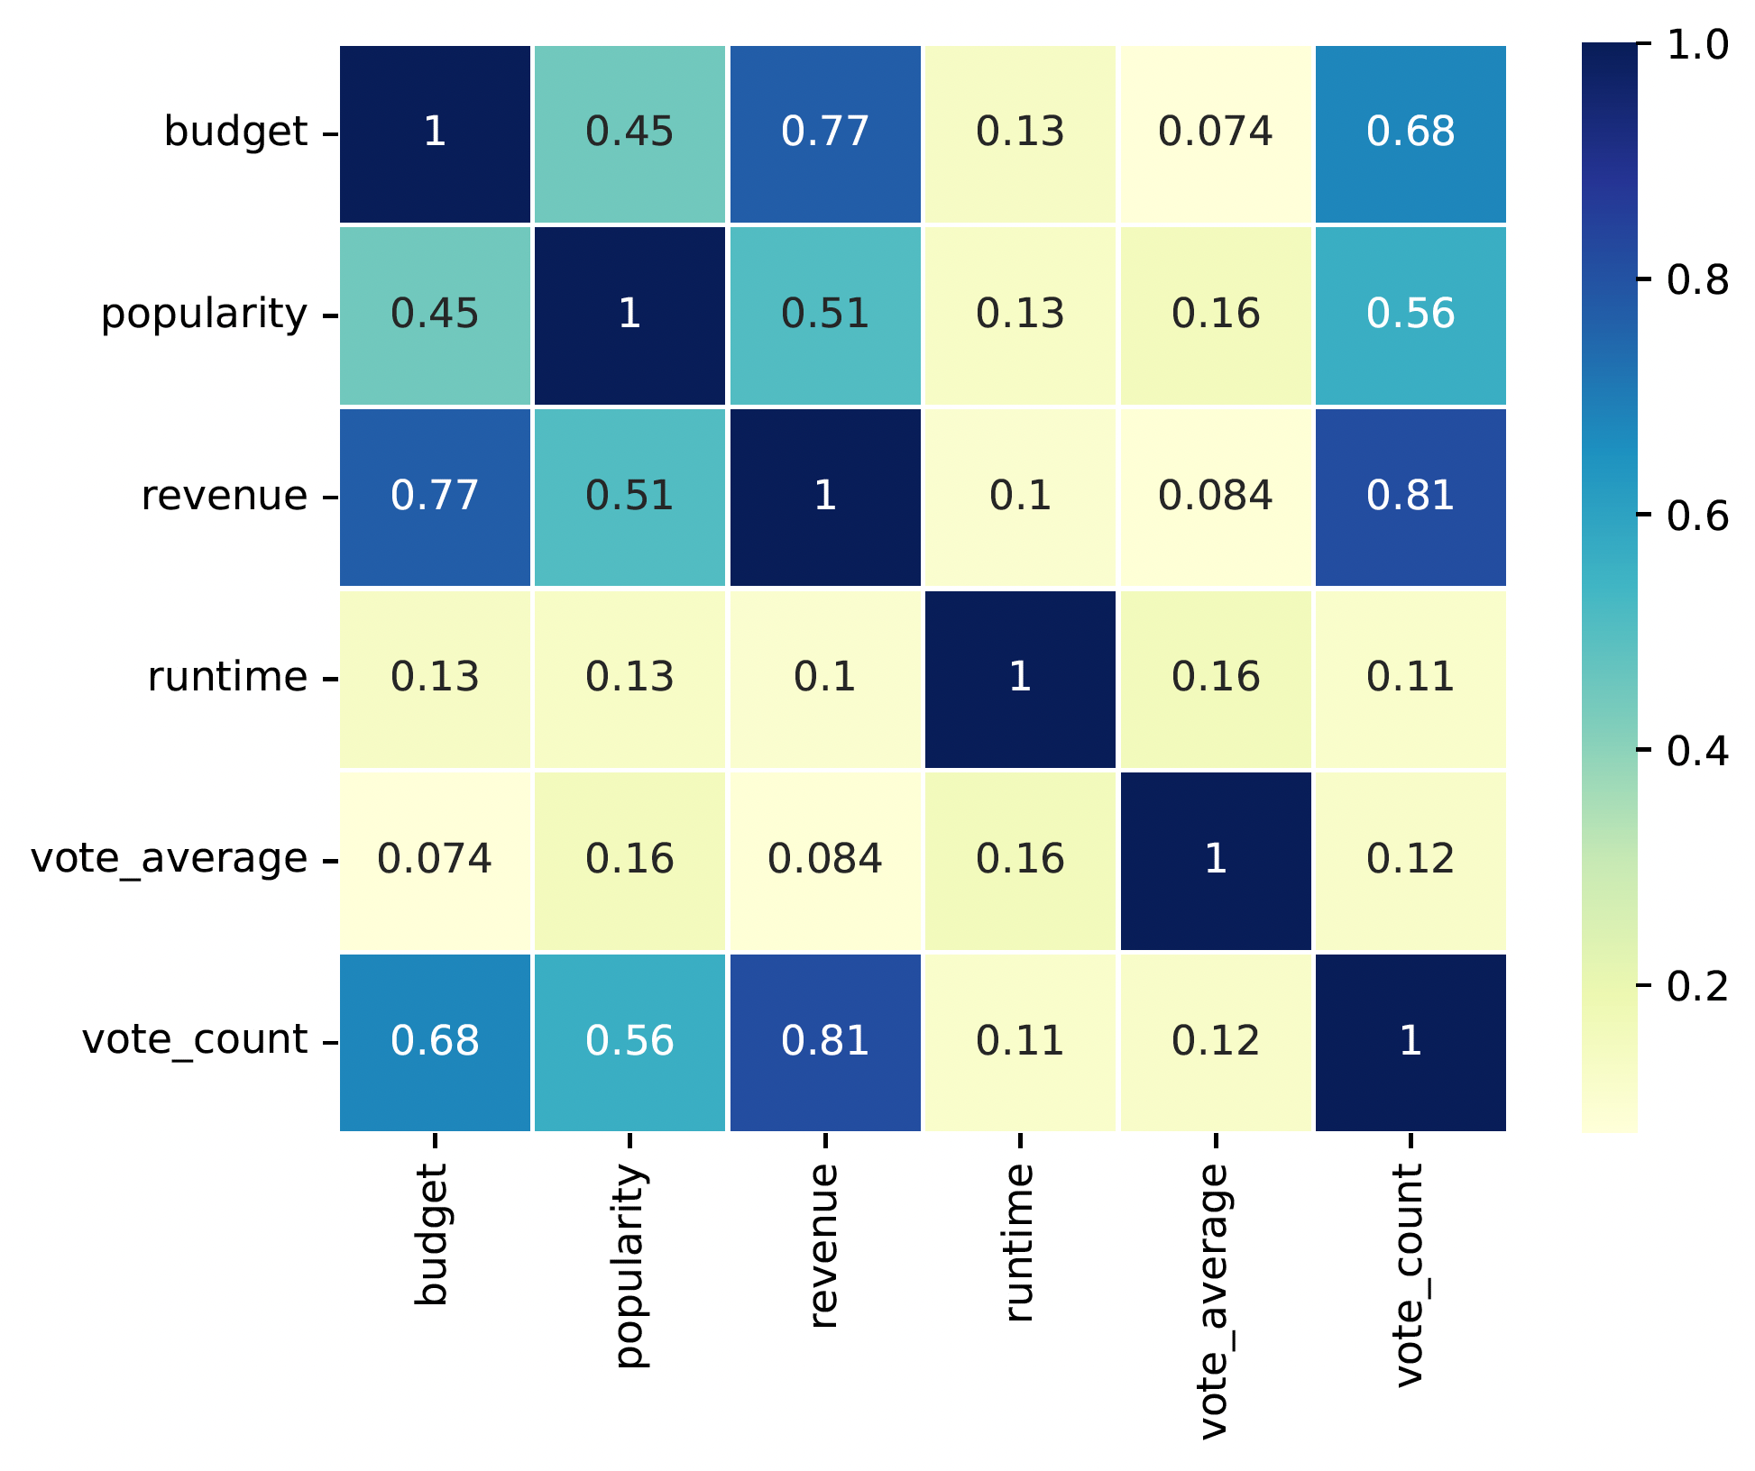
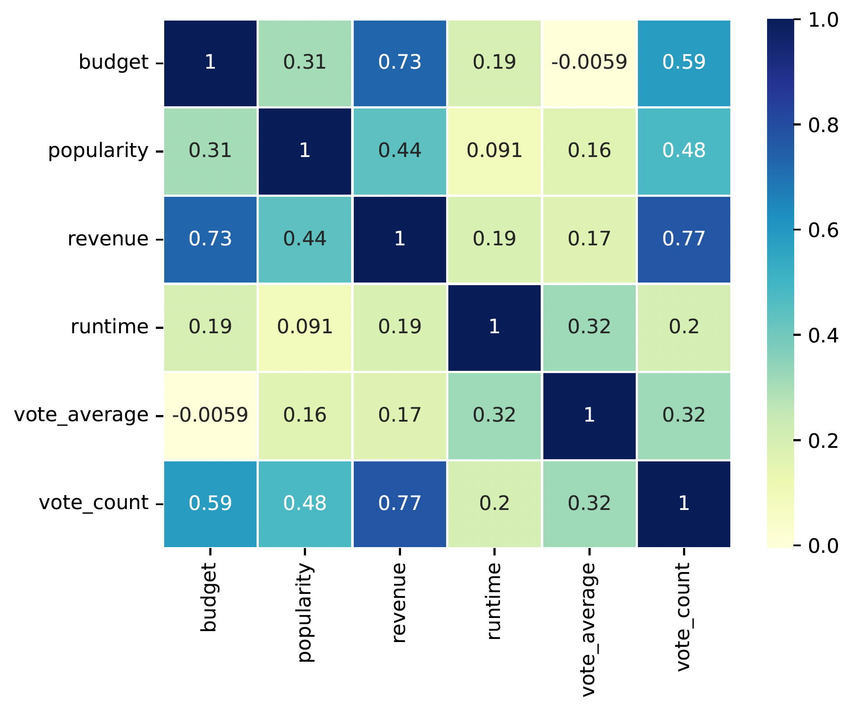
PREDICTION MODEL: Correlation matrix

Slide 16
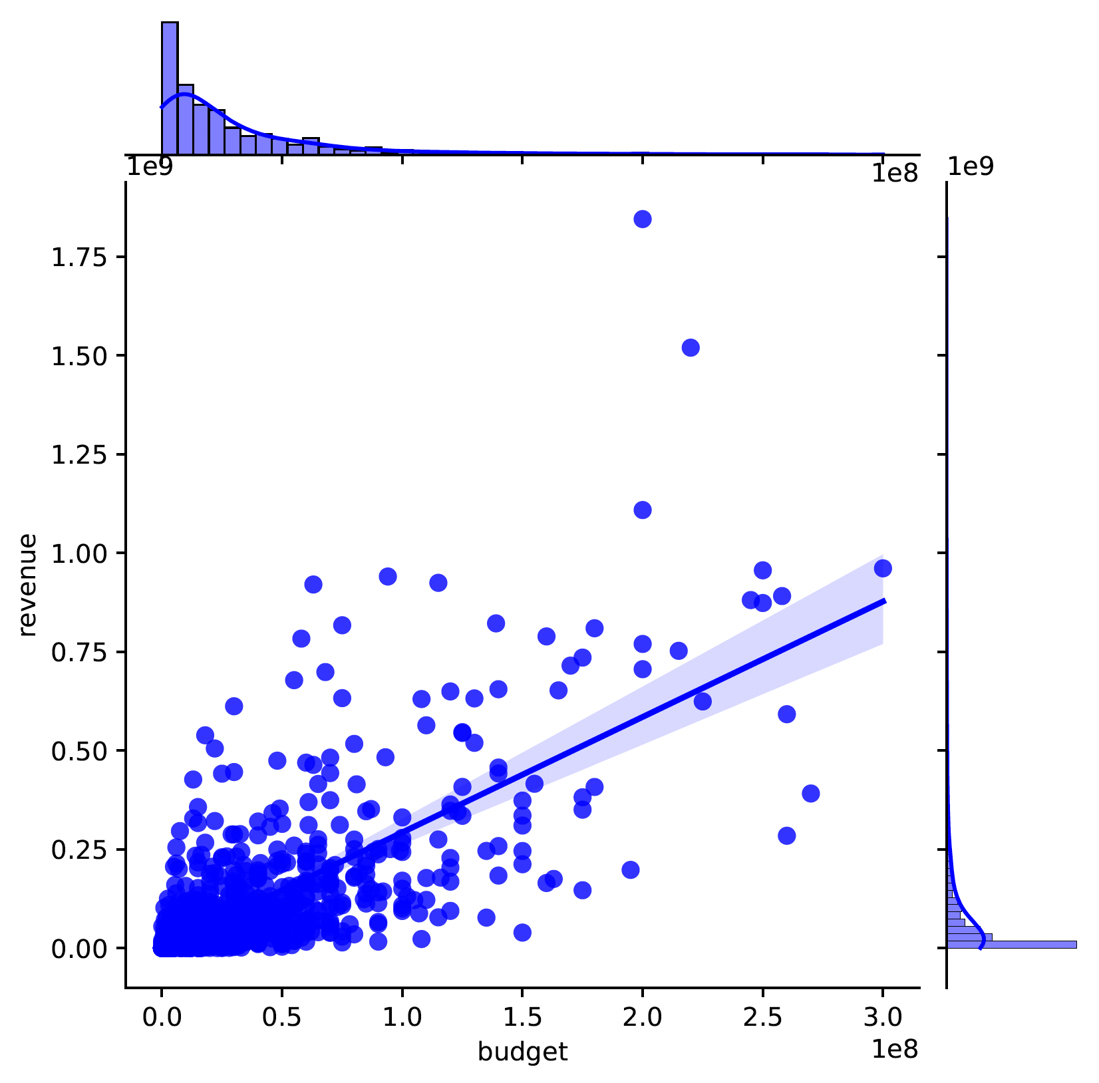
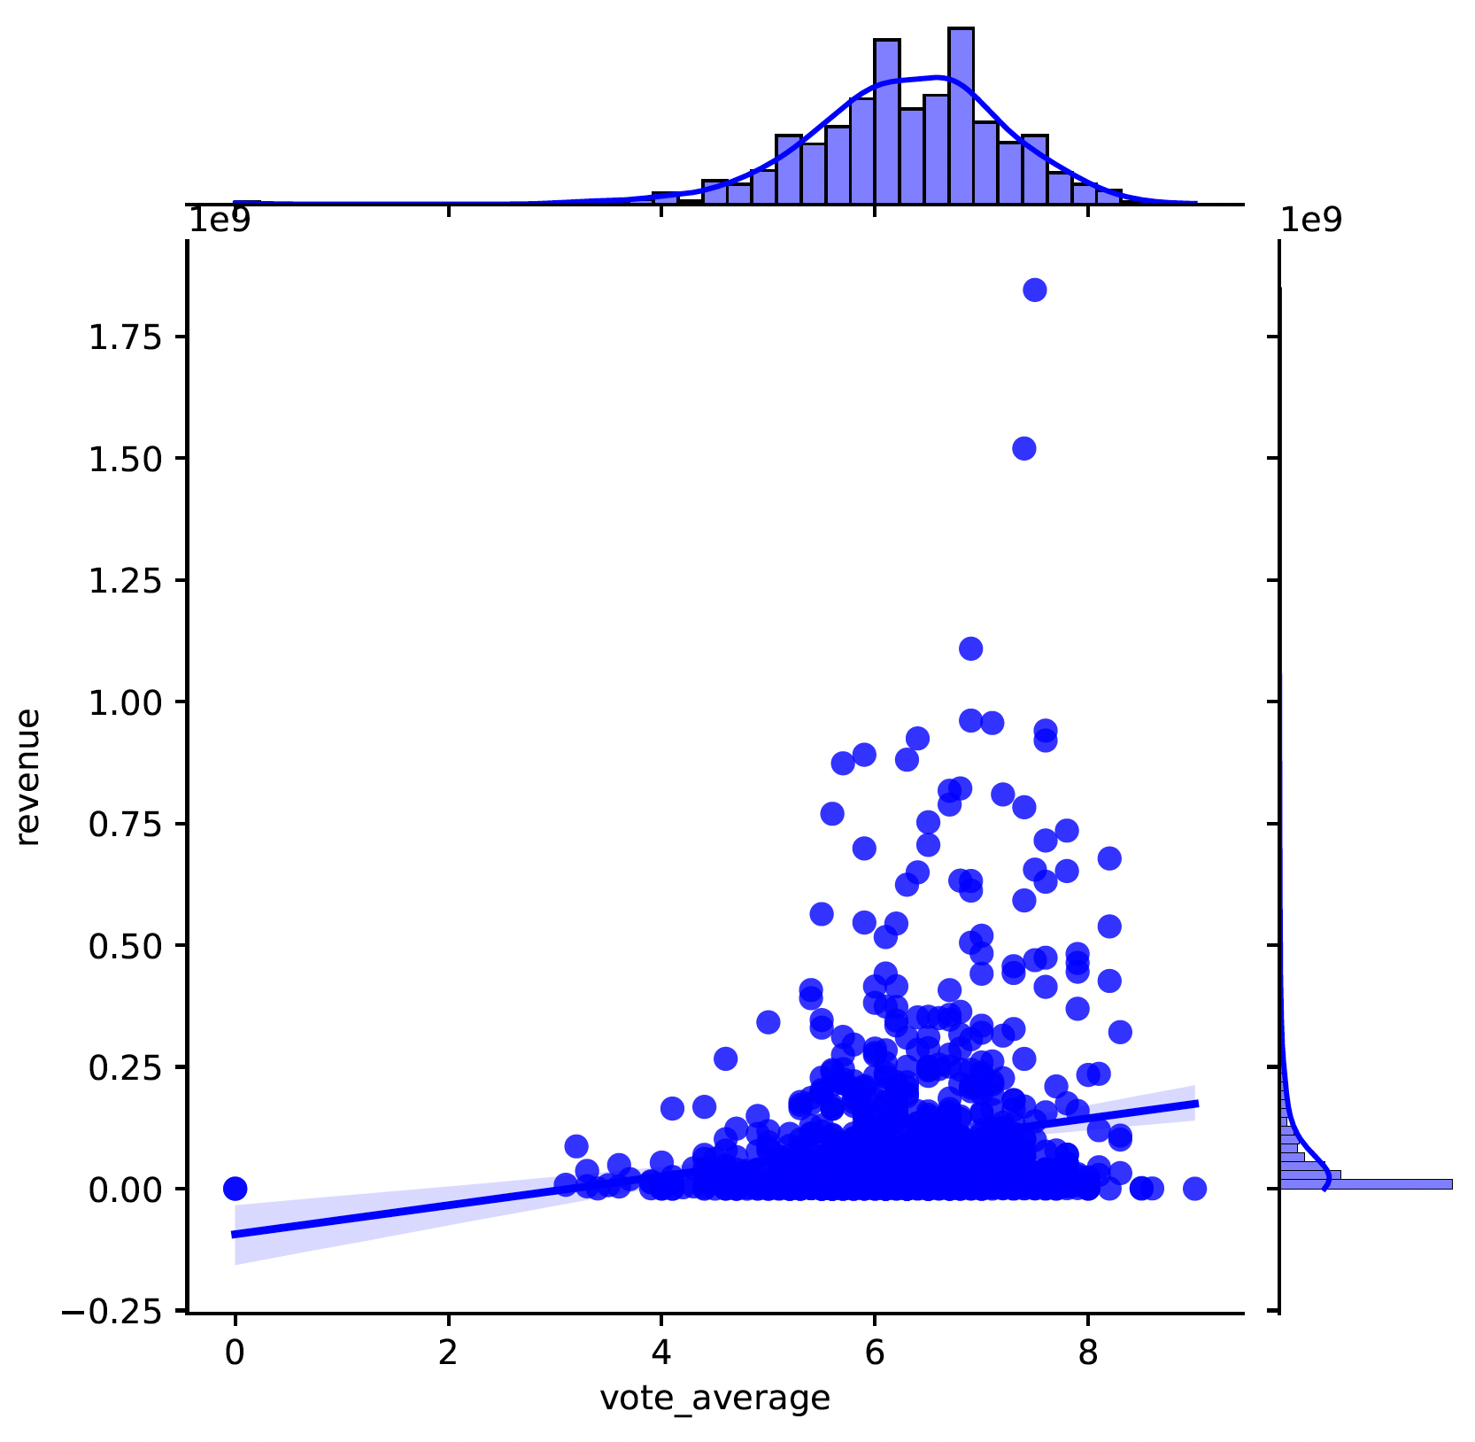
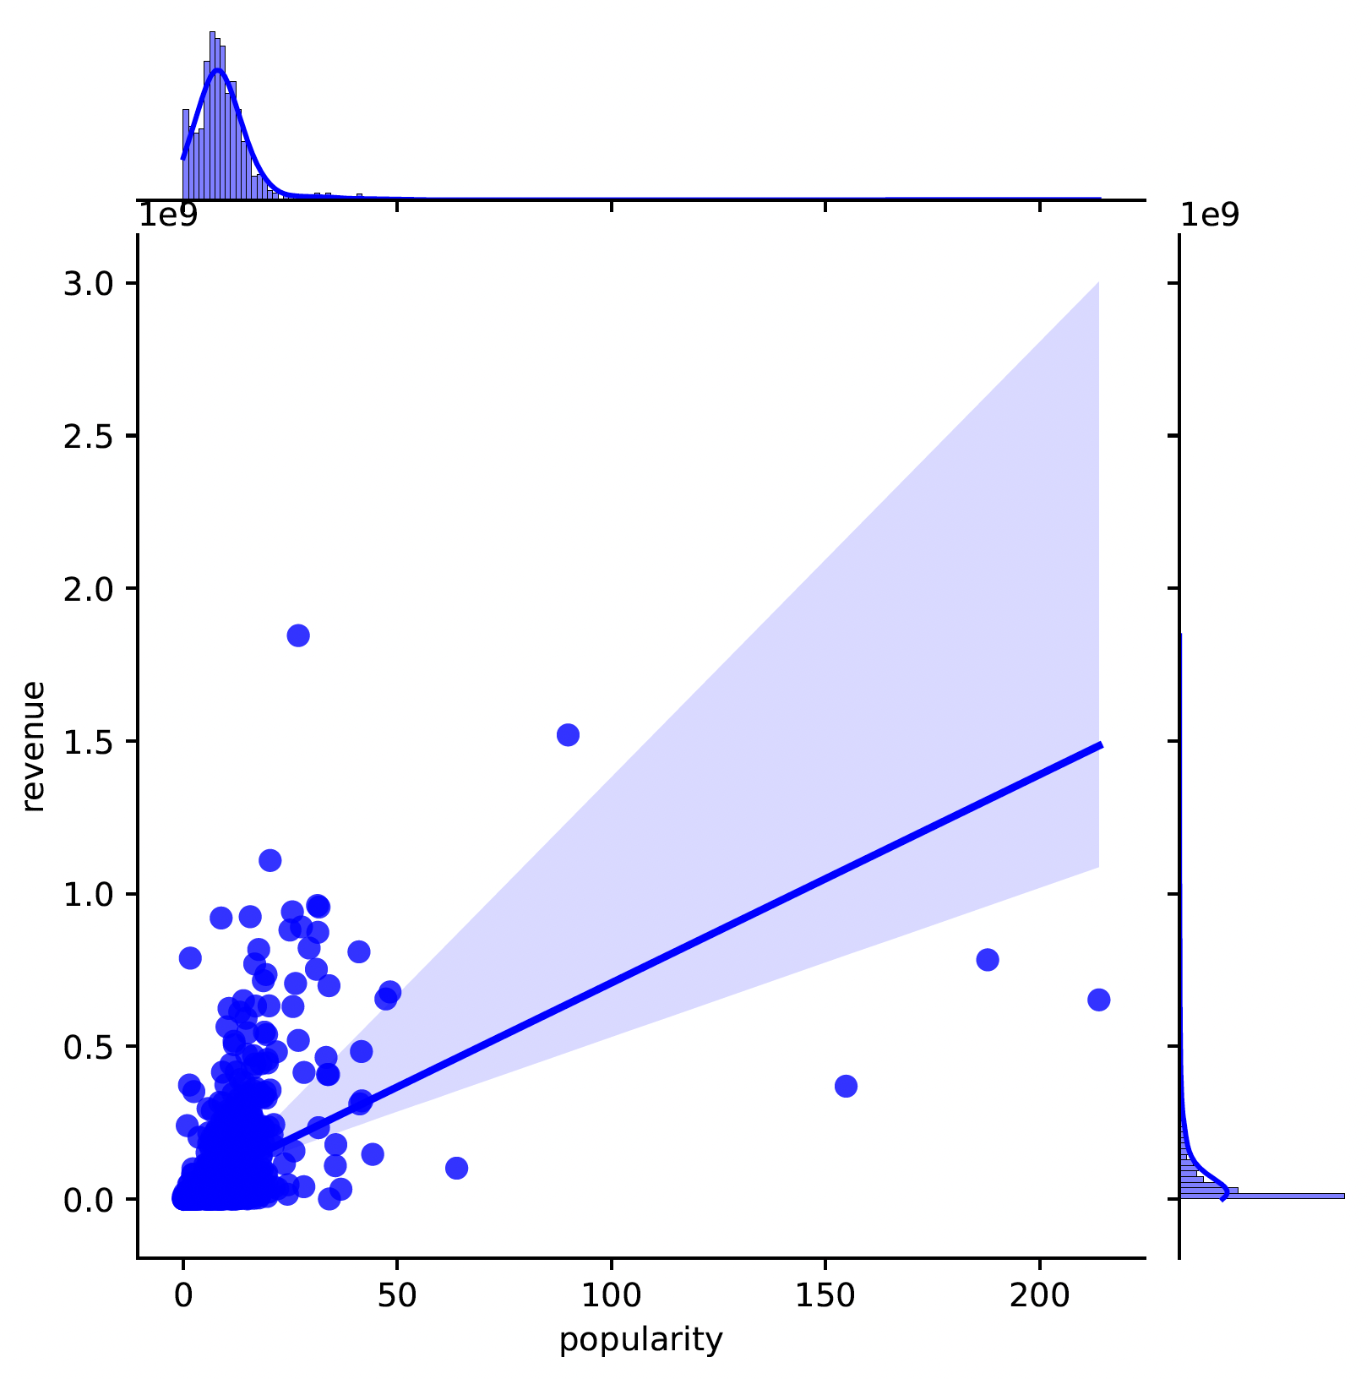
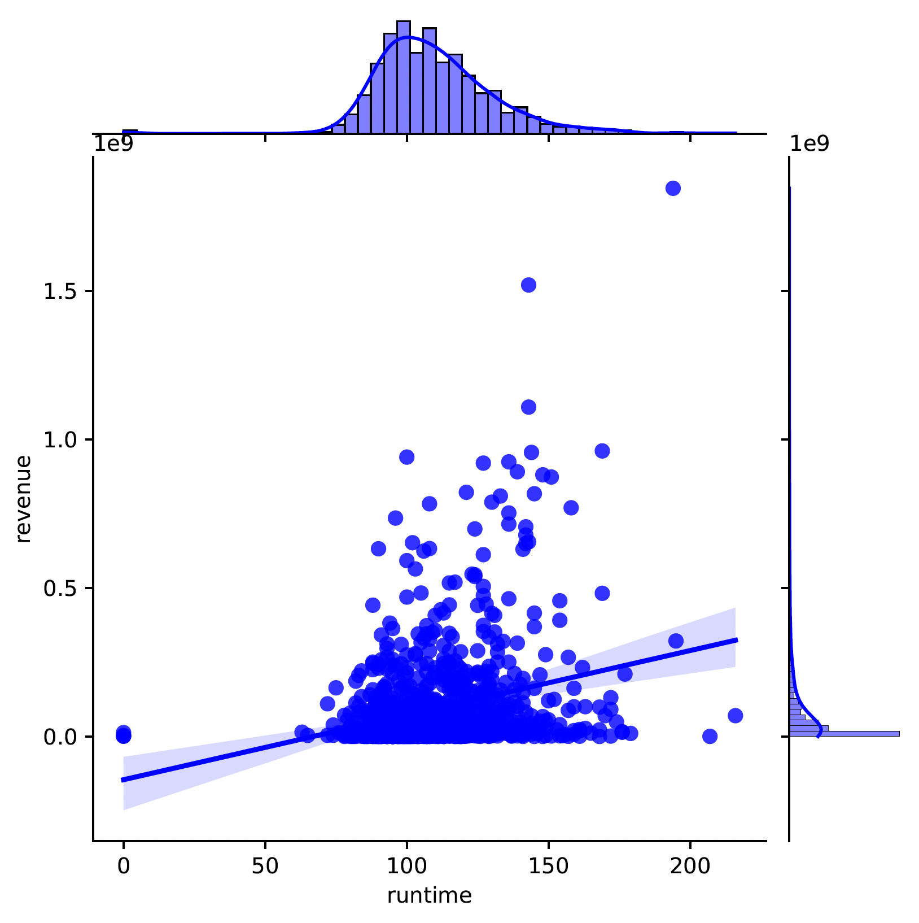
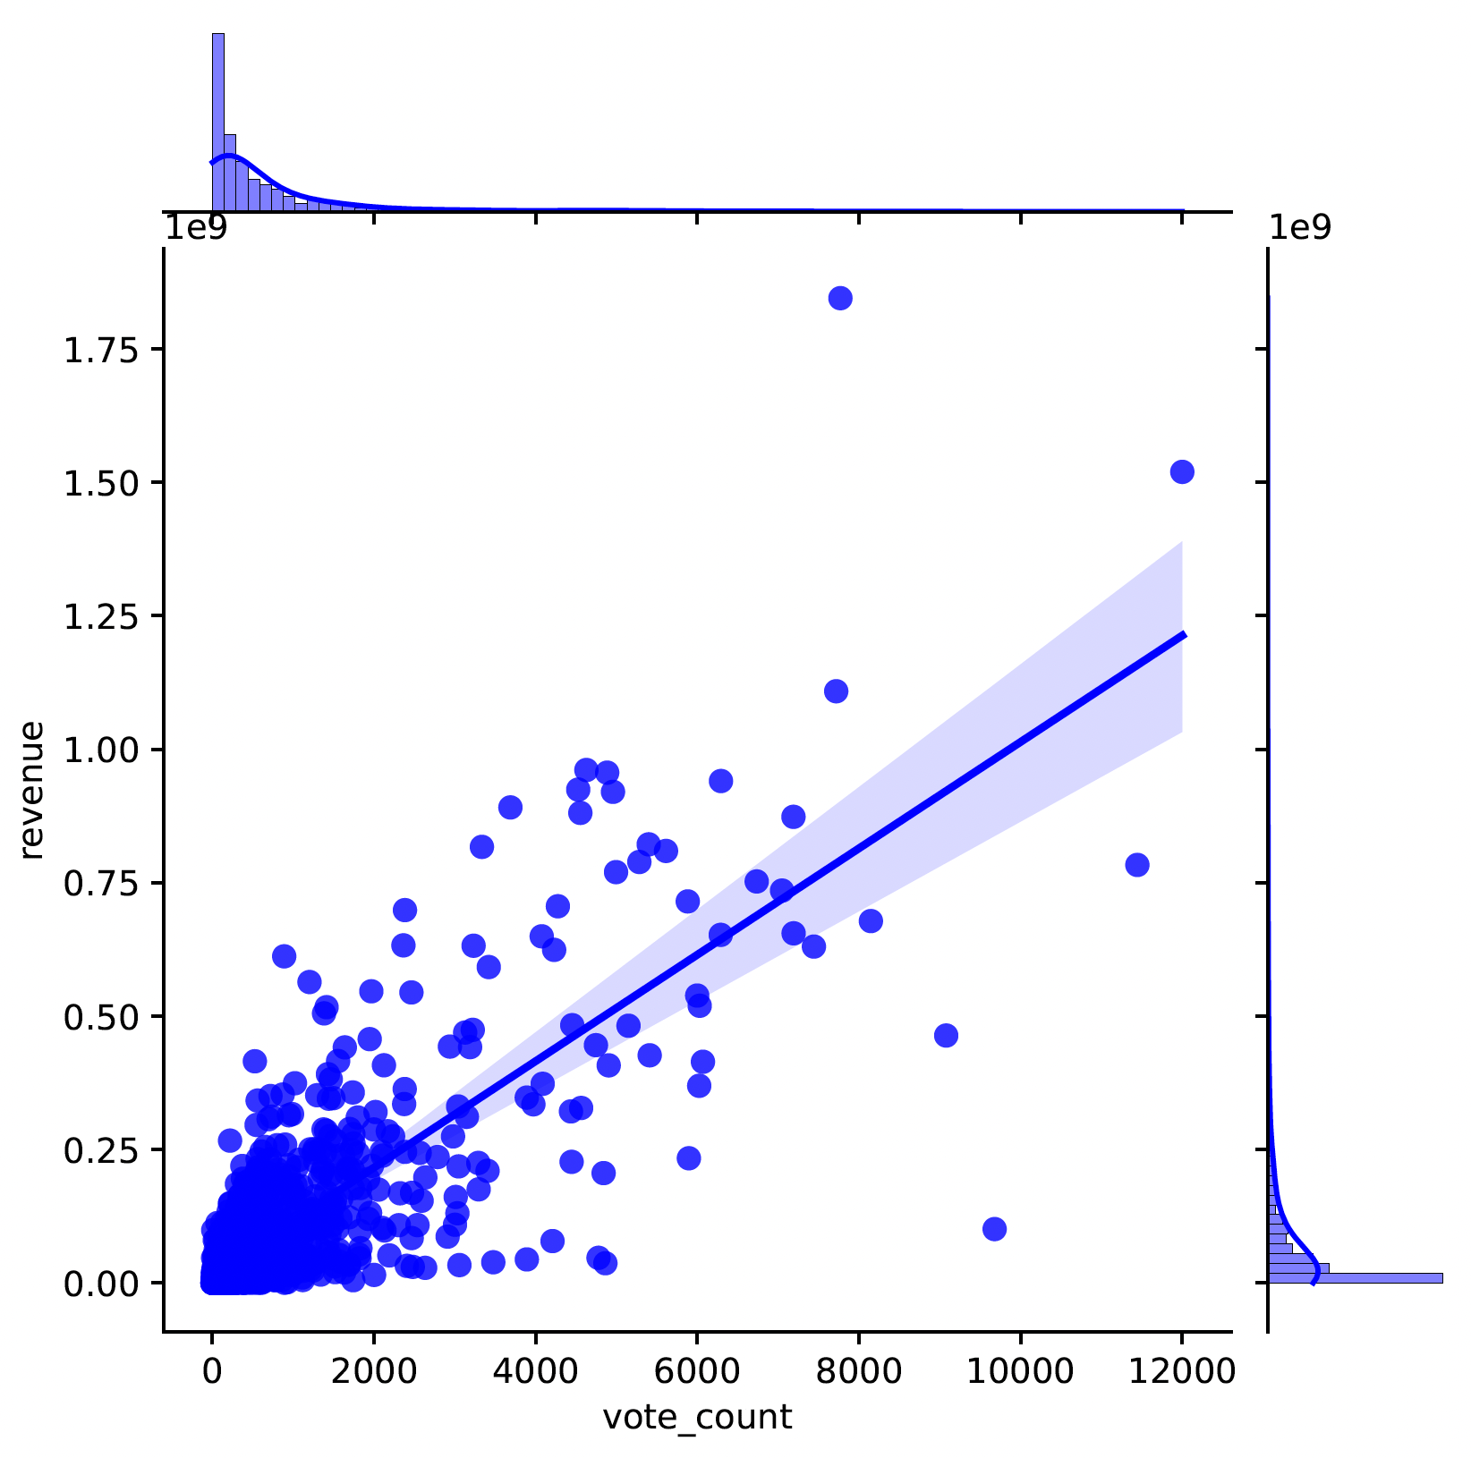
PREDICTION MODEL: Jointplots

Slide 17
PREDICTION MODEL
Training data: 20%, Testing data: 80%
Multivariable linear regression on all five independent variables.
Multivariable linear regression on budget, vote_count and revenue.
budget | 1.6041
popularity | 250316.07
vote_count | 74422.61
runtime | -696291.88
vote_average | -2744485.56
RMSE | 9233499.36
R^2 | 0.69
budget | 1.645
vote_count | 70178.09
RMSE | 90237741.20
R^2 | 0.704
RMSE lower than other regression models such as KNeighborsRegressor and Random Forest Regressor

Slide 18
PREDICTION MODEL: Limitations
Only numerical attributes included in the model.
Categorical variables such as genre, cast, languages do affect the movie revenue.
Did not incorporate movie ratings to the prediction model.

Slide 19
REFERENCES:
lvaro González, Fernando Ortega, Diego Pérez-López, and Santiago Alonso. 2022. Bias and Unfairness of Collaborative Filtering Based Recommender Systems in MovieLens Dataset. IEEE Access 10 (2022), 68429–68439. https://doi.org/10.1109/ ACCESS.2022.3186719
Guijia He and Soowon Lee. 2015. Multi-model or Single Model? A Study of Movie Box-Office Revenue Prediction. (2015), 321–325. https://doi.org/10.1109/CIT/ IUCC/DASC/PICOM.2015.46
Dietmar Jannach, Pearl Pu, Francesco Ricci, and Markus Zanker. 2021. Recommender Systems: Past, Present, Future. AI Magazine 42 (2021), 3–6. Issue 3.
Sambandam Jayalakshmi, Narayanan Ganesh, Robert Cep, and Janakiraman Senthil Murugan. 2022. Movie Recommender Systems: Concepts, Methods, Challenges, and Future Directions.Sensors (2022).https://www.mdpi.com/1424-8220/22/13/4904
Dawei Li and Zhi-Ping Liu. 2022. Predicting Box-Office Markets with Machine Learning Methods. Entropy (Basel, Switzerland) 24 (2022). Issue 5. https://doi.org/10.3390/e24050711
Rahul Pradhan, Ashish Chandra Swami, Akash Saxena, and Vikram Rajpoot. 2021.
A Study on Movie Recommendations using Collaborative Filtering. IOP Conf. Series: Materials Science and Engineering (2021). https://iopscience.iop.org/article/10.1088/1757-899X/1119/1/012018/pdf
Nahid Quader, Md. Osman Gani, and Dipankar Chaki. 2017. Performance evaluation of seven machine learning classification techniques for movie box office success prediction.2017 3rd International Conference on Electrical Information and Communication Technology (EICT) (2017), 1–6. https://api.semanticscholar.org/CorpusID:25140665
Mojtaba Sadeghian and Mohammad Khansari. 2018. A Recommender Systems. Based on Similarity Networks: MovieLens Case Study. (2018), 705–709. https://doi.org/10.1109/ISTEL.2018.8661141
Phonexay Vilakone, Doo-Soon Park, Khamphaphone Xinchang, and Fei Hao. 2018. An Efficient movie recommendation algorithm based on improved k-clique. Human-centric Computing and Information Sciences (2018). https://doi.org/10.1186/s13673-018-0161-64

Slide 20
THANK YOU

